Slide 1
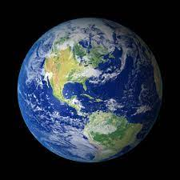
ENVIRONMENTAL STUDIES
UNIT-III-NATURAL RESOURCES

Slide 2
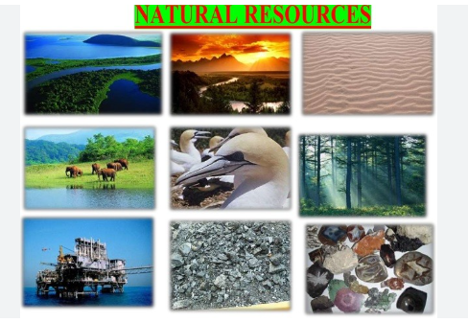

Slide 3
NATURAL RESOURCES
These are the resources that are found in the environment
Developed without the intervention of humans.
include air, sunlight, water, soil, stone, plants, animals and fossil fuels.

Slide 4
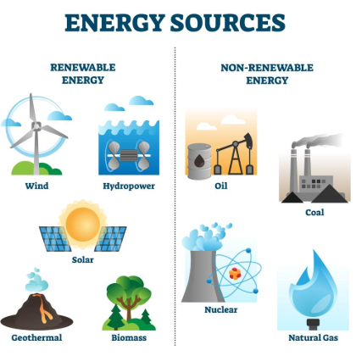
NATURAL RESOURCES
Natural resources are classified based on availability into:
Renewable Resources: Infinite and replenishable, e.g., forests, wind, water.
Non-Renewable Resources: Finite and exhaustible, e.g., fossil fuels, minerals.

Slide 5
WATER RESOURCES
Water is one of the most essential resources
Domestic Use: Drinking, cooking, cleaning, and sanitation.
Industrial Use: Manufacturing, cooling, and as a solvent in many processes.
Agricultural Use: Irrigation for crops and livestock farming.
Power Generation: Hydroelectric power is a renewable energy source derived from flowing water.
Support for Aquatic Life: Oceans, rivers, and lakes are habitats for diverse aquatic organisms.

Slide 6
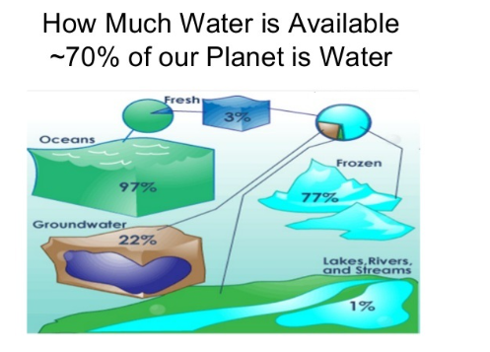

Slide 7
Availability
70% of earth’s surface is water, most of that is ocean.
3% (by volume) of all water on earth is fresh water
Only 1% is easily accessible surface freshwater

Slide 8
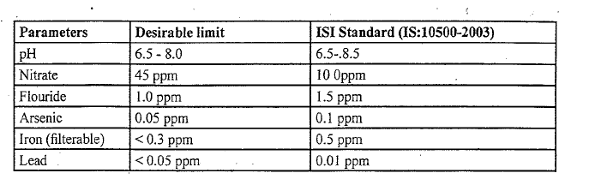
Water Quality parameters and standard
Parameters-PH,nitrates,flourides,arsenic,iron,lead
High nitrate levels can cause methemoglobinemia (blue baby syndrome) in infants and affect oxygen transport in the blood. Lead is highly toxic, even in small amounts, and can cause neurological damage.

Slide 9
Turbidity & Total hardness
Turbidity is a measure of the cloudiness of a liquid, typically caused by suspended particles such as dirt, clay, silt, organic matter, or microorganisms.
It is an important water quality parameter used to indicate the clarity of water.
ISI (IS 10500:2012): Desirable limit for drinking water is 1 NTU(Nephelometric Turbidity Units)

Slide 10
Turbidity & Total hardness
Total Hardness refers to the concentration of dissolved calcium and magnesium salts in water.
Expressed as milligrams of calcium carbonate (CaCO₃) per liter (mg/L). ·
Temporary Hardness: Hardness caused by dissolved bicarbonates of calcium and magnesium, which can be removed by boiling the water.
Permanent Hardness: Hardness caused by dissolved sulfates, chlorides, or nitrates of calcium and magnesium, which cannot be removed by boiling.
The sum of temporary and permanent hardness gives the total hardness of water
Desirable Limit: 200 mg/L (as CaCO₃)
Permissible Limit: 600 mg/L

Slide 11
Water quality standards
Parameters | ISI standard(IS 10500-2003)
pH | 6.5-8.5
Nitrate | 100ppm
Flouride | 1.5ppm
Arsenic | 0.1ppm
Iron | 0.5ppm
Lead | 0.01ppm
Turbidity | 10NTU
Total hardness | 600ppm

Slide 12
MPN (most probable number)
statistical method used to estimate the concentration of viable microorganisms (such as bacteria) in water
MPN is commonly used to assess the presence of coliform bacteria
MPN (Most Probable Number) test, the result is typically expressed as MPN per 100 mL for water samples.
The MPN value is calculated using the pattern of positive and negative results across different dilutions.
If you have one positive result in one of the dilution sets (and negative results in the others), the MPN value could be around 2.2 MPN per 100 mL

Slide 13
Water related diseases
Water borne & water induced :
Water borne - directly caused by contaminated water that contains harmful microorganisms or or toxic substances like chemicals, waste, or fertilizers.
(ex:cholera,typhoid,meningitis)
“induced diseases”- diseases caused by indirect impact of water
(dehydration,weight loss)

Slide 14
Diseases from pesticides/fertilizers
1.Excessive nitrates-blue baby syndrome
2.DDT/Heptachlor-
-neurological problem+cancer
3.Industrial waste-(seepage of toxic pollutants)

Slide 15
Fluoride problem in drinking water
Water is a major source of flouride.
It is an effective agent to treat dental carries(optimal amounts)
Toothpaste contains fluoride
Fluoride content should not be more than 1.5 mg/L
Dental fluorosis-discolored,blackened,disfigured teeth
Skeletal Fluorosis: Chronic exposure to high fluoride levels can cause permanent joint deformities and stiffness.

Slide 16
Prevention of water related diseases
Improved Public sanitation
Provide clean water
Treat waste water

Slide 17
MINERAL RESOURCES
Naturally occurring substances that are classified based on their composition and uses
metallic and non-metallic resources

Slide 18
5 most mined minerals
Coal
Petroleum
Iron Ore
Aluminum (Bauxite)
Phosphate Rock

Slide 19
5 most mined minerals
Metallic Resources
Aluminum Ores (Bauxite):
Source: Bauxite (Al₂O₃·nH₂O).
Major Locations in India: Bihar, Gujarat, Andhra Pradesh, Goa, Karnataka.
Uses: Lightweight metal used in transportation, construction, and packaging.
Iron Ores:
Major Locations in India: Odisha, Chhattisgarh, Jharkhand, Karnataka.
Uses: Steel production.
Chromite:
Major Locations in India: Odisha, Karnataka.
Uses: Stainless steel production.
Copper Ores:
Major Locations in India: Rajasthan, Jharkhand, Madhya Pradesh.
Uses: Electrical wiring, coins, and alloys

Slide 20
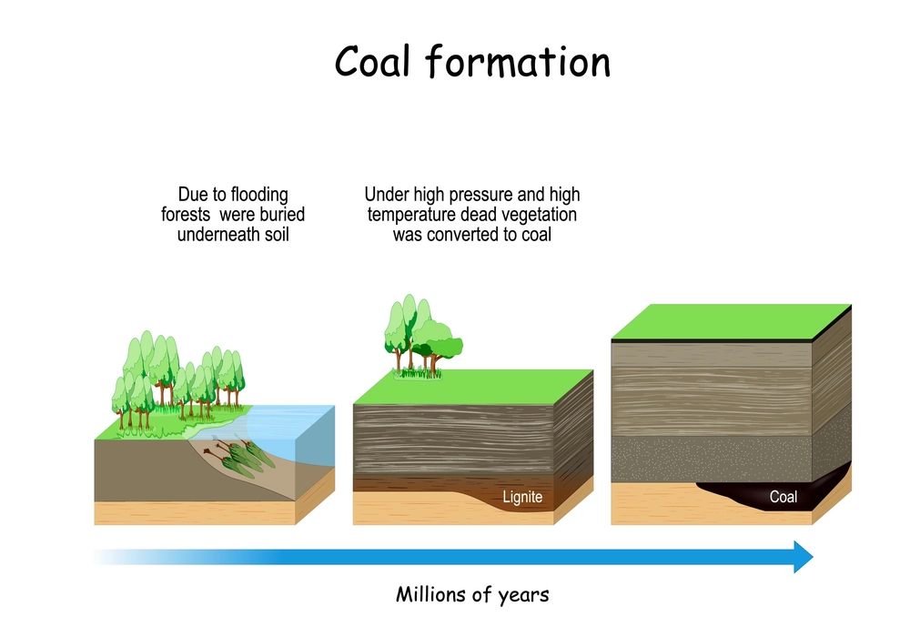
Non metal resources
The formation of coal occurs over millions of years via a process known as carbonation. In this process, dead vegetation is converted into carbon-rich coal under very high temperature and pressure.

Slide 21
Non metal resources
Key Uses of Coal:
Domestic fuel.
Electricity generation (thermal power plants).
Production of coke for steelmaking.
Raw material in industrial processes.

Slide 22
Non metal resources
Petroleum: A complex mixture of hydrocarbons in liquid form found trapped within rocks.
Petrol is a liquid fuel derived from crude oil through a process called refining.
During refining, crude oil is heated and separated into various components, including petrol, diesel, kerosene, and aviation fuel.
Transportation fuel, power generation, and petrochemical industry.

Slide 23
Non metal resources
Petroleum:
Crude Oil Formation:
Formed from the remains of marine microorganisms like plankton and algae.
These organisms settled on the seabed millions of years ago and were buried under layers of sediment.
Over millions of years, heat and pressure converted this organic matter into a liquid mixture of hydrocarbons trapped in porous rocks beneath the Earth’s surface.

Slide 24
Other major non metals
Asbestos: Used for insulation and fireproof materials.
Phosphate Rock: Used for fertilizers.
Potash: Useful in agriculture and industrial applications.
Muscovite Mica:
India: Leading producer globally.
Uses: Electrical insulation.

Slide 25
FOREST RESOURCES
1/3 rd of earths land surface is forest
They are called “earth’s lungs”
Wood ranks first as a raw material for the manufacture of other products

Slide 26
FOREST RESOURCES
Key benefits of forests:
They are extremely important to humans & natural world
Provides clean water
Provides home to unique plants & animals
Source of economic growth
Provides clean air
Provides recreational opportunities

Slide 27
Deforestation
It means loss of forest cover.
Land that is permanently converted from forest to agricultural land,cattle, pasteures,homes,lakes etc.
Major cases can be:
1)Agriculture
2)Commercial logging
3)Mining and construction

Slide 28
Bad effects
Destruction of bio diversity
Dry up of moist forest land
No recycling of water

Slide 29
Remedies
1.Reduce consumption of forest and related products
2.Boycott product of companies involved in deforestation
3.Compel govt. and industry to make changes
4.Open communication & group discussions(involving govt. NGO)

Slide 30
Different types of Energy
Conventional and non Conventional

Slide 31
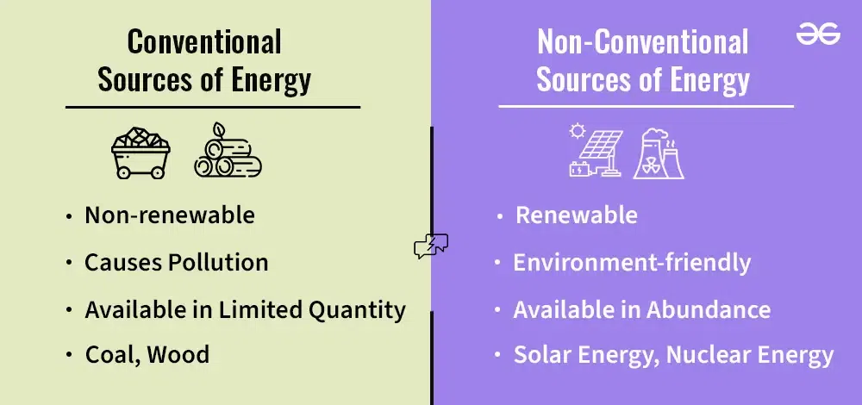
Conventional vs Non-Conventional Sources of Energy

Slide 32
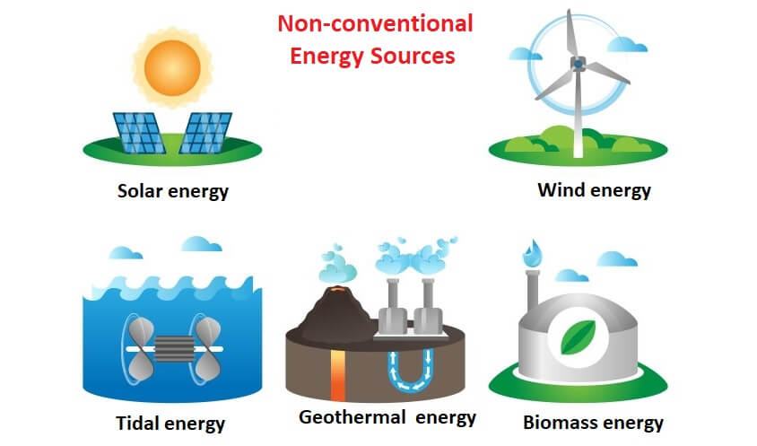

Slide 33
HYDROELECTRIC POWER
Electricity produced from generators driven by turbines that convert the potential energy of falling or fast-flowing water into mechanical energy.

Slide 34
HYDROELECTRIC POWER
India has 197 hydro power plants.
Hydropower development in India began in the late 19th century:
In 1897, the Sidrapong Hydropower Plant in Darjeeling was the first hydroelectric plant in the country.
In 1902, the Sivasamudram Hydropower Station in Karnataka

Slide 35
Wind Power
A form of energy conversion where wind turbines transform the
kinetic energy of wind into mechanical or electrical energy for use.
Renewable and eco-friendly.
Harnesses natural wind flow without emitting greenhouse gases.
Along with solar power and hydroelectric power, it is one of the
most commonly used renewable energy sources globally.
Plays a significant role in reducing reliance on fossil fuels.

Slide 36
Wind Power
India has a total installed wind power capacity of approximately 44.7 GW (gigawatts).
Muppandal Wind Farm: Located in Kanyakumari, Tamil Nadu, this is one of the largest wind power plants in India with a capacity of 1,500 megawatts.
Jaisalmer Wind Park: Located in Jaisalmer, Rajasthan, this is one of the largest wind power plants in India with a capacity of 1,064 megawatts.

Slide 37
Solar Power
Solar energy systems use radiation from the sun to produce heat and electricity. There are three basic categories of solar energy systems:
Photovoltaic (PV) systems use solar-electric cells that convert solar radiation directly into electricity for powering small devices or generating electricity in solar power plants.
Solar thermal heating systems use solar collectors to absorb solar radiation to heat water or air for space heating and water heating.
Solar thermal power plants use concentrating solar collectors to focus the sun's rays to heat a fluid to a high temperature for generating electricity.

Slide 38
Solar Power
India is among the top solar energy producers globally, with an installed capacity of 70.01 GW as of 2023.
Part of the National Solar Mission aiming for 280 GW of solar capacity by 2030.
Bhadla Solar Park (Rajasthan): One of the largest solar parks in the world.
Pavagada Solar Park (Karnataka): Another large solar facility in India.

Slide 39
Biogas
Biogas is an environmentally-friendly, renewable energy source produced by the breakdown of organic matter such as food scraps and animal waste.
Organic matter, such as food or animal waste, is broken down by microorganisms in the absence of oxygen. This process is called anaerobic digestion.
Biogas is promoted under schemes like the National Biogas and
Manure Management Programme (NBMMP).
Used extensively in rural areas for cooking and small-scale
power generation.

Slide 40
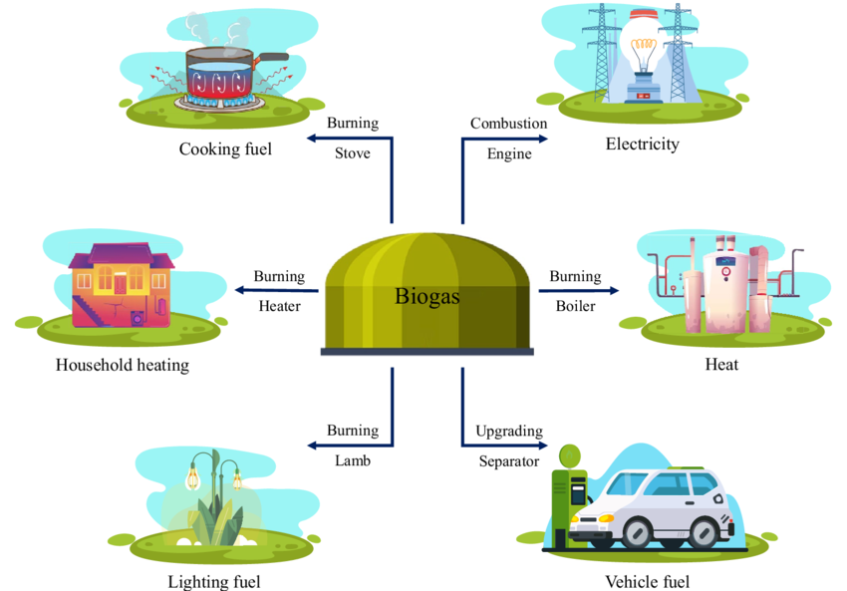

Slide 41
Hydrogen as an Alternate Future Source of Energy
Hydrogen is a clean and sustainable energy source with the potential to replace fossil fuels. It can be produced from renewable energy sources and is highly efficient.
Hydrogen, when used as a fuel, produces water vapor as the only by-product.
Unlike fossil fuels, it does not emit greenhouse gases or air pollutants.
It contributes significantly to reducing carbon emissions, aligning with global climate goals.

Slide 42
Hydrogen Production Methods
Electrolysis: Splitting water into hydrogen and oxygen using electricity.
Steam Methane Reforming (SMR): Extracting hydrogen from methane.
Biological Processes: Using microbes to produce hydrogen.
Thermochemical Processes: High-temperature methods using nuclear or solar heat.

Slide 43
Applications of Hydrogen Energy
Transportation: Hydrogen fuel cells for vehicles.
Power Generation: Hydrogen-powered turbines.
Industrial Use: Steel and chemical manufacturing.
Energy Storage: Long-term storage for renewable energy.
Advantages of Hydrogen
Challenges in Adopting Hydrogen
Environmentally Friendly: Produces only water as a byproduct.
Cost of Production: Green hydrogen is
expensive.
Infrastructure Requirements: Lack of refueling stations.
Abundant Resource: Available everywhere.
Energy Efficient: High energy content per unit weight.
Storage and Transportation: Requires high pressure or low temperatures.
Versatile: Can be used in various sectors.
Safety Concerns: Highly flammable.

